Slide 1
FlightGear Simulator Automatic Pilot

Slide 2
Features
MVP:
Read script from file
Automatic takeoff
Automatic flight
V1
Fully planned flight from point A to point B via script
Future version
Bfs algorithm based route planning
Interface with AI for script handling
Git repository - https://github.com/h74-projects/autopilot.git

Slide 3
Group - Los Patos
Amir Schvartz
Rasheed Balawna
Shoham Mualem

Slide 4
Amir Schvartz
B.A in Musical Composition from the Jesrusalem Academy For Music And Dance
Last work as a Highschool music teacher and private Piano teacher

Slide 5
Shoham Mualem
•B.Ed in teaching the Bible and Talmud from Orot Israel Academy.
•Last job as a rabby educator in a high school Yeshiva and teacher for mathematics

Slide 6
Rasheed Balawna
B.Sc Cum Laude in Mapping and Geo-Informatics, Technion.
Lead Mapping and Geo-Informatics engineer & Licensed Surveyor at Geo-Point Ltd.

Slide 7
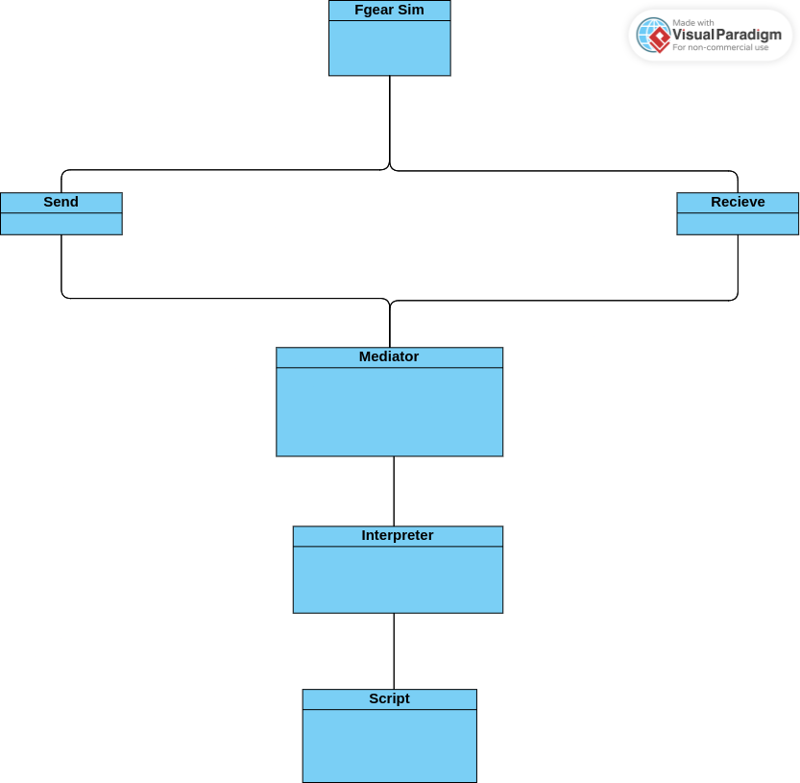
High Level Design

